Slide 1
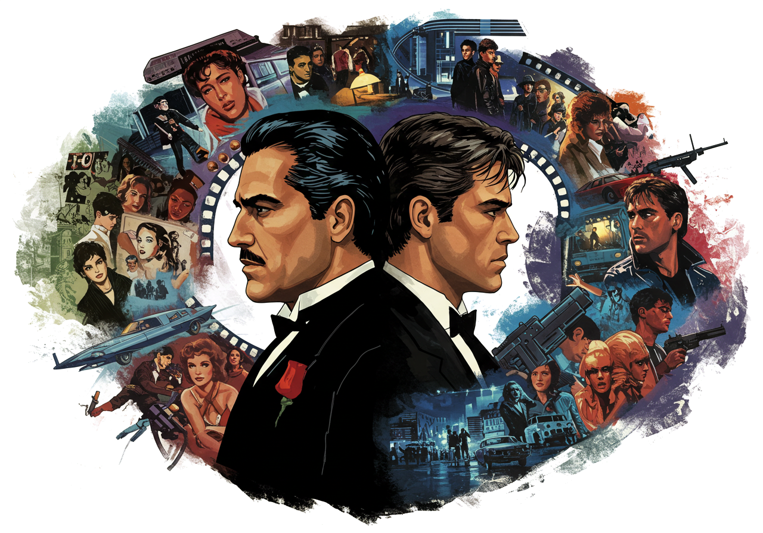

[CS372]
Minjae
Kyung
Using Neural Network .
Movie Revenue Prediction
Notes:
Hi everyone! I'm Minjae Kyung, and today I’ll talk about my CS372 final project on "Movie Revenue Prediction Using Neural Network."

Slide 2


[Movie
Reveneue]
Outline
[CS372]
Notes:
For this project, I've set out to develop a model that can predict movie revenues based on their metadata. I'm working with the IMDB movie dataset from Kaggle, and my primary approach is to use a Neural Network algorithm to identify patterns that influence box office performance.

Slide 3


[Movie
Reveneue]
Outline
[CS372]
Notes:
For this project, I've set out to develop a model that can predict movie revenues based on their metadata. I'm working with the IMDB movie dataset from Kaggle, and my primary approach is to use a Neural Network algorithm to identify patterns that influence box office performance.

Slide 4

[Movie
Reveneue]
Outline
[CS372]
Background
Notes:
For this project, I've set out to develop a model that can predict movie revenues based on their metadata. I'm working with the IMDB movie dataset from Kaggle, and my primary approach is to use a Neural Network algorithm to identify patterns that influence box office performance.

Slide 5
Outline
[Movie
Reveneue]
Background
[CS372]
Notes:
Let me explain the approach a bit more. The plan is to transform various movie metadata into vectors through embedding techniques, then feed these vectors into a Neural Network for training. Why did I choose a Neural Network for this task? There are three main reasons: First, Neural Networks excel at capturing complex non-linear patterns that might exist in our data. Second, they're quite flexible when it comes to integrating different types of input data. And third, they have the advantage of automatically learning interactions between various features.

Slide 6
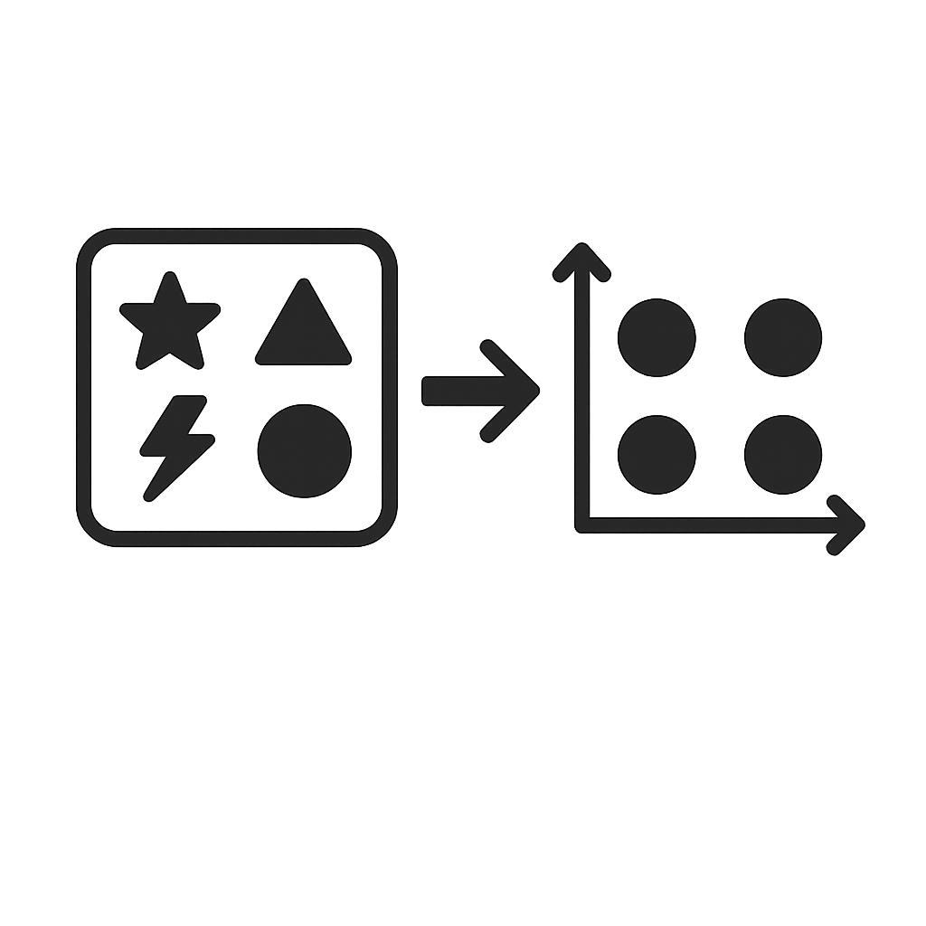
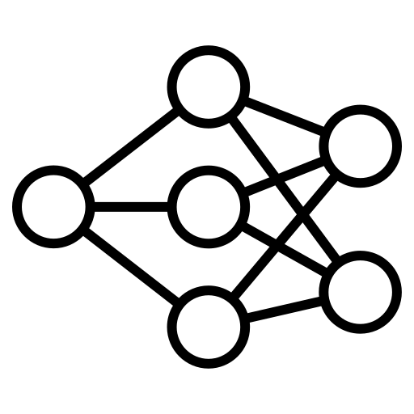
[Movie
Reveneue]
Background
[CS372]
Notes:
Let me explain the approach a bit more. The plan is to transform various movie metadata into vectors through embedding techniques, then feed these vectors into a Neural Network for training.

Slide 7

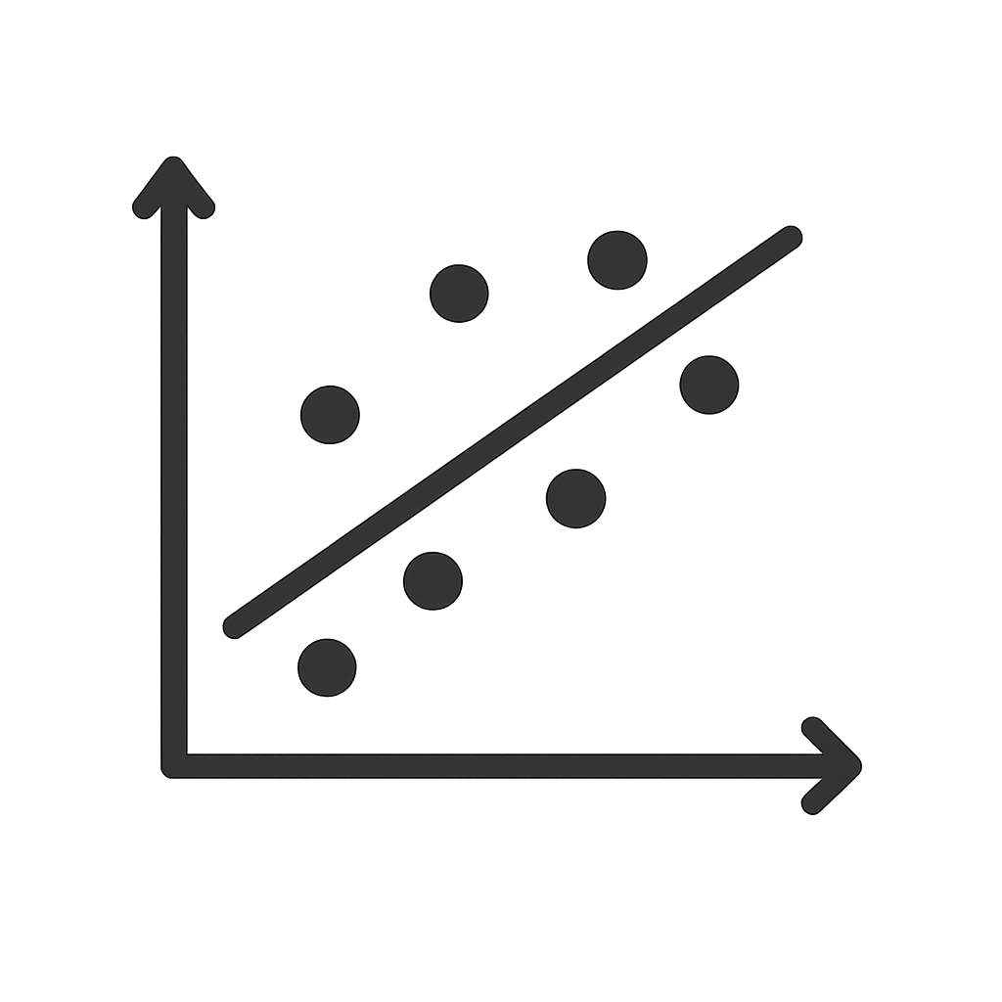

[Movie
Reveneue]
Background
Embedding
[CS372]
Notes:
That said, I'm keeping my options open—if this approach doesn't yield the results we're hoping for, I'm prepared to pivot to alternatives like Linear Regression or Random Forest.

Slide 8
[Movie
Reveneue]
Background
Embedding
[CS372]
Notes:
Now, let's talk about the two key technical elements in this project. The first is embedding. This technique transforms categorical data, such as text, into dense vector forms that computers can process effectively. What's fascinating about embedding is that data with similar meanings end up positioned close to each other in the vector space, essentially creating a numerical representation of semantic relationships.

Slide 9
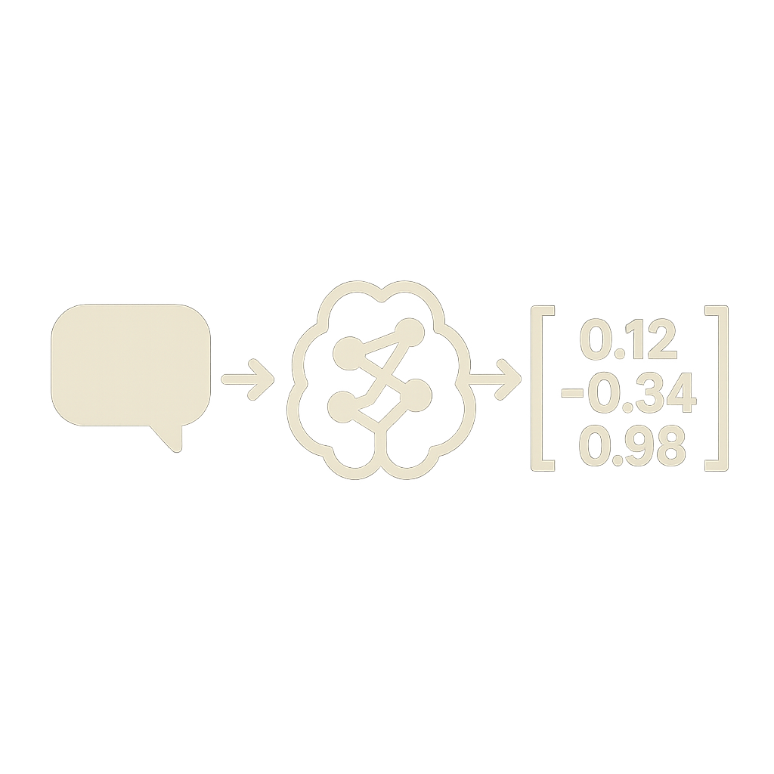
[Movie
Reveneue]
Embedding
[CS372]
Notes:
Now, let's talk about the two key technical elements in this project. The first is embedding. This technique transforms categorical data, such as text, into dense vector forms that computers can process effectively. What's fascinating about embedding is that data with similar meanings end up positioned close to each other in the vector space, essentially creating a numerical representation of semantic relationships.

Slide 10
[Movie
Reveneue]
Embedding
[CS372]
Notes:
Now, let's talk about the two key technical elements in this project. The first is embedding. This technique transforms categorical data, such as text, into dense vector forms that computers can process effectively. What's fascinating about embedding is that data with similar meanings end up positioned close to each other in the vector space, essentially creating a numerical representation of semantic relationships.

Slide 11
[Movie
Reveneue]
Embedding
Neural Network
[CS372]
Notes:
Now, let's talk about the two key technical elements in this project. The first is embedding. This technique transforms categorical data, such as text, into dense vector forms that computers can process effectively. What's fascinating about embedding is that data with similar meanings end up positioned close to each other in the vector space, essentially creating a numerical representation of semantic relationships.

Slide 12
[Movie
Reveneue]
Embedding
Neural Network
[CS372]
Notes:
The second key element is, of course, the Neural Network itself. As you may know, Neural Networks draw inspiration from the structure of neurons in the human brain. They're built with an input layer, hidden layers, and an output layer, with neurons in each layer connected through weights and activation functions. During training, the Backpropagation algorithm adjusts these weights to minimize the loss function, which helps the model make increasingly accurate predictions over time.

Slide 13
[Movie
Reveneue]
Neural Network
[CS372]
Notes:
The second key element is, of course, the Neural Network itself. As you may know, Neural Networks draw inspiration from the structure of neurons in the human brain. They're built with an input layer, hidden layers, and an output layer, with neurons in each layer connected through weights and activation functions. During training, the Backpropagation algorithm adjusts these weights to minimize the loss function, which helps the model make increasingly accurate predictions over time.

Slide 14
[Movie
Reveneue]
Neural Network
[CS372]
Motivation
Notes:
The second key element is, of course, the Neural Network itself. As you may know, Neural Networks draw inspiration from the structure of neurons in the human brain. They're built with an input layer, hidden layers, and an output layer, with neurons in each layer connected through weights and activation functions. During training, the Backpropagation algorithm adjusts these weights to minimize the loss function, which helps the model make increasingly accurate predictions over time.

Slide 15


Neural Network
[Movie
Reveneue]
Motivation
[CS372]
Overview
Notes:
This model offers practical value to film industry stakeholders. Producers can make informed early decisions with revenue forecasts, investors can assess risks quantitatively, and market trend analysis can highlight profitable genres and production methods.

Slide 16
Motivation
[Movie
Reveneue]
Overview
[CS372]
Notes:
Regarding our methodology, we'll start with thorough data cleaning to ensure quality by addressing missing values and outliers. The data will then be divided into training and test sets, and we'll optimize hyperparameters using 5-fold cross-validation to ensure our model generalizes well.

Slide 17
[Movie
Reveneue]
Overview
[CS372]
Notes:
Regarding our methodology, we'll start with thorough data cleaning to ensure quality by addressing missing values and outliers. The data will then be divided into training and test sets, and we'll optimize hyperparameters using 5-fold cross-validation to ensure our model generalizes well.

Slide 18
[Movie
Reveneue]
Overview
[CS372]
Notes:
Regarding our methodology, we'll start with thorough data cleaning to ensure quality by addressing missing values and outliers. The data will then be divided into training and test sets, and we'll optimize hyperparameters using 5-fold cross-validation to ensure our model generalizes well.

Slide 19
[Movie
Reveneue]
Overview
[CS372]
Notes:
I've set some specific goals for this project. First, I aim to limit the average error between predicted and actual revenues to within 30%. Beyond accuracy, I want to ensure the model performs consistently across different genres and budget scales, avoiding any bias toward particular types of films.

Slide 20
[Movie
Reveneue]
Overview
30%
[CS372]
Data
Notes:
I've set some specific goals for this project. First, I aim to limit the average error between predicted and actual revenues to within 30%. Beyond accuracy, I want to ensure the model performs consistently across different genres and budget scales, avoiding any bias toward particular types of films.

Slide 21
Overview
30%
[Movie
Reveneue]
Data
Samples
Samples
903,263
20
[CS372]
Notes:
Let's talk about our dataset. I'm using Kaggle's "IMDB Movie Dataset," which contains 903,263 movie entries with 20 features including ID, title, and vote average. It's worth noting that this dataset requires significant cleaning—just removing entries with missing values will likely reduce our sample size to around 120,000. A critical task will be ensuring the reliability of our final dataset after we've also addressed outliers.

Slide 22
30%
[Movie
Reveneue]
Data
id | title | Vote average | Vote count | status | Release date
revenue | runtime | adult | budget | Original language | Original title
overview | popularity | tagline | genres | Production companies | Production countries
Spoken languages | keywords
[CS372]
Algorithm
Notes:
Let's talk about our dataset. I'm using Kaggle's "IMDB Movie Dataset," which contains 903,263 movie entries with 20 features including ID, title, and vote average. It's worth noting that this dataset requires significant cleaning—just removing entries with missing values will likely reduce our sample size to around 120,000. A critical task will be ensuring the reliability of our final dataset after we've also addressed outliers.

Slide 23

Data
id | title | Vote average | Vote count | status | Release date
revenue | runtime | adult | budget | Original language | Original title
overview | popularity | tagline | genres | Production companies | Production countries
Spoken languages | keywords
[Movie
Reveneue]
Algorithm
[CS372]
Notes:
For implementation, I'm initially planning to use scikit-learn's MLPRegressor. If time permits, I'd like to explore more complex architectures using PyTorch. For processing text data, I plan to apply Word2Vec to keywords and genres, while using Sentence-BERT for longer texts like movie overviews.

Slide 24

[Movie
Reveneue]
Algorithm
[CS372]
Challenges
Notes:
For implementation, I'm initially planning to use scikit-learn's MLPRegressor. If time permits, I'd like to explore more complex architectures using PyTorch. For processing text data, I plan to apply Word2Vec to keywords and genres, while using Sentence-BERT for longer texts like movie overviews.

Slide 25


Algorithm
[Movie
Reveneue]
Challenges
[CS372]
Future Timeline
Notes:
Of course, there are challenges ahead. Two main ones come to mind: First, we'll need iterative experimentation to find the optimal Neural Network configuration. Second, we may face reliability issues due to significant data reduction during cleaning. To address these challenges, I'll implement systematic experimental design and validation procedures.

Slide 26
Challenges
[Movie
Reveneue]
Future Timeline
 |  |  |  |  |  | 29
30 | 31 | 1 | 2 | 3 | 4 | 5
6 | 7 | 8 | 9 | 10 | 11 | 12
13 | 14 | 15 | 16 | 17 | 18 | 19
[CS372]
Notes:
Looking at our timeline, I'm aiming to complete data cleaning and the basic model configuration by this weekend.

Slide 27
[Movie
Reveneue]
Future Timeline
 |  |  |  |  |  | 29
30 | 31 | 1 | 2 | 3 | 4 | 5
6 | 7 | 8 | 9 | 10 | 11 | 12
13 | 14 | 15 | 16 | 17 | 18 | 19
[CS372]
Notes:
Looking at our timeline, I'm aiming to complete data cleaning and the basic model configuration by this weekend.

Slide 28
[Movie
Reveneue]
Future Timeline
 |  |  |  |  |  | 29
30 | 31 | 1 | 2 | 3 | 4 | 5
6 | 7 | 8 | 9 | 10 | 11 | 12
13 | 14 | 15 | 16 | 17 | 18 | 19
[CS372]
Notes:
From March 31st to April 6th, I'll focus on model training and hyperparameter optimization. If the Neural Network shows promising results, I'll continue refining the model and documenting my findings in the research notebook.

Slide 29
[Movie
Reveneue]
Future Timeline
 |  |  |  |  |  | 29
30 | 31 | 1 | 2 | 3 | 4 | 5
6 | 7 | 8 | 9 | 10 | 11 | 12
13 | 14 | 15 | 16 | 17 | 18 | 19
[CS372]
Reference
V. Udandarao, and P. Gupta, “Movie Revenue Prediction Using Machine Learning Models,” 2003, arXiv:2405.11651.
Notes:
However, if the Neural Network approach doesn't meet our expectations, I'll pivot to alternative models such as Linear Regression or Random Forest.

Slide 30
Future Timeline
 |  |  |  |  |  | 29
30 | 31 | 1 | 2 | 3 | 4 | 5
6 | 7 | 8 | 9 | 10 | 11 | 12
13 | 14 | 15 | 16 | 17 | 18 | 19
[Movie
Reveneue]
Reference
V. Udandarao, and P. Gupta, “Movie Revenue Prediction Using Machine Learning Models,” 2003, arXiv:2405.11651.
[CS372]
Notes:
These are the references that have informed my approach to this project.

Slide 31
Future Timeline
 |  |  |  |  |  | 29
30 | 31 | 1 | 2 | 3 | 4 | 5
6 | 7 | 8 | 9 | 10 | 11 | 12
13 | 14 | 15 | 16 | 17 | 18 | 19
Thank you!
[CS372]
Notes:
Thank you very much.

